Slide 1
Implementation of Winograd Convolution
ACA class project @ Politecnico di Milano
by Castiglioni Matteo and Loiacono Tommaso

Slide 2
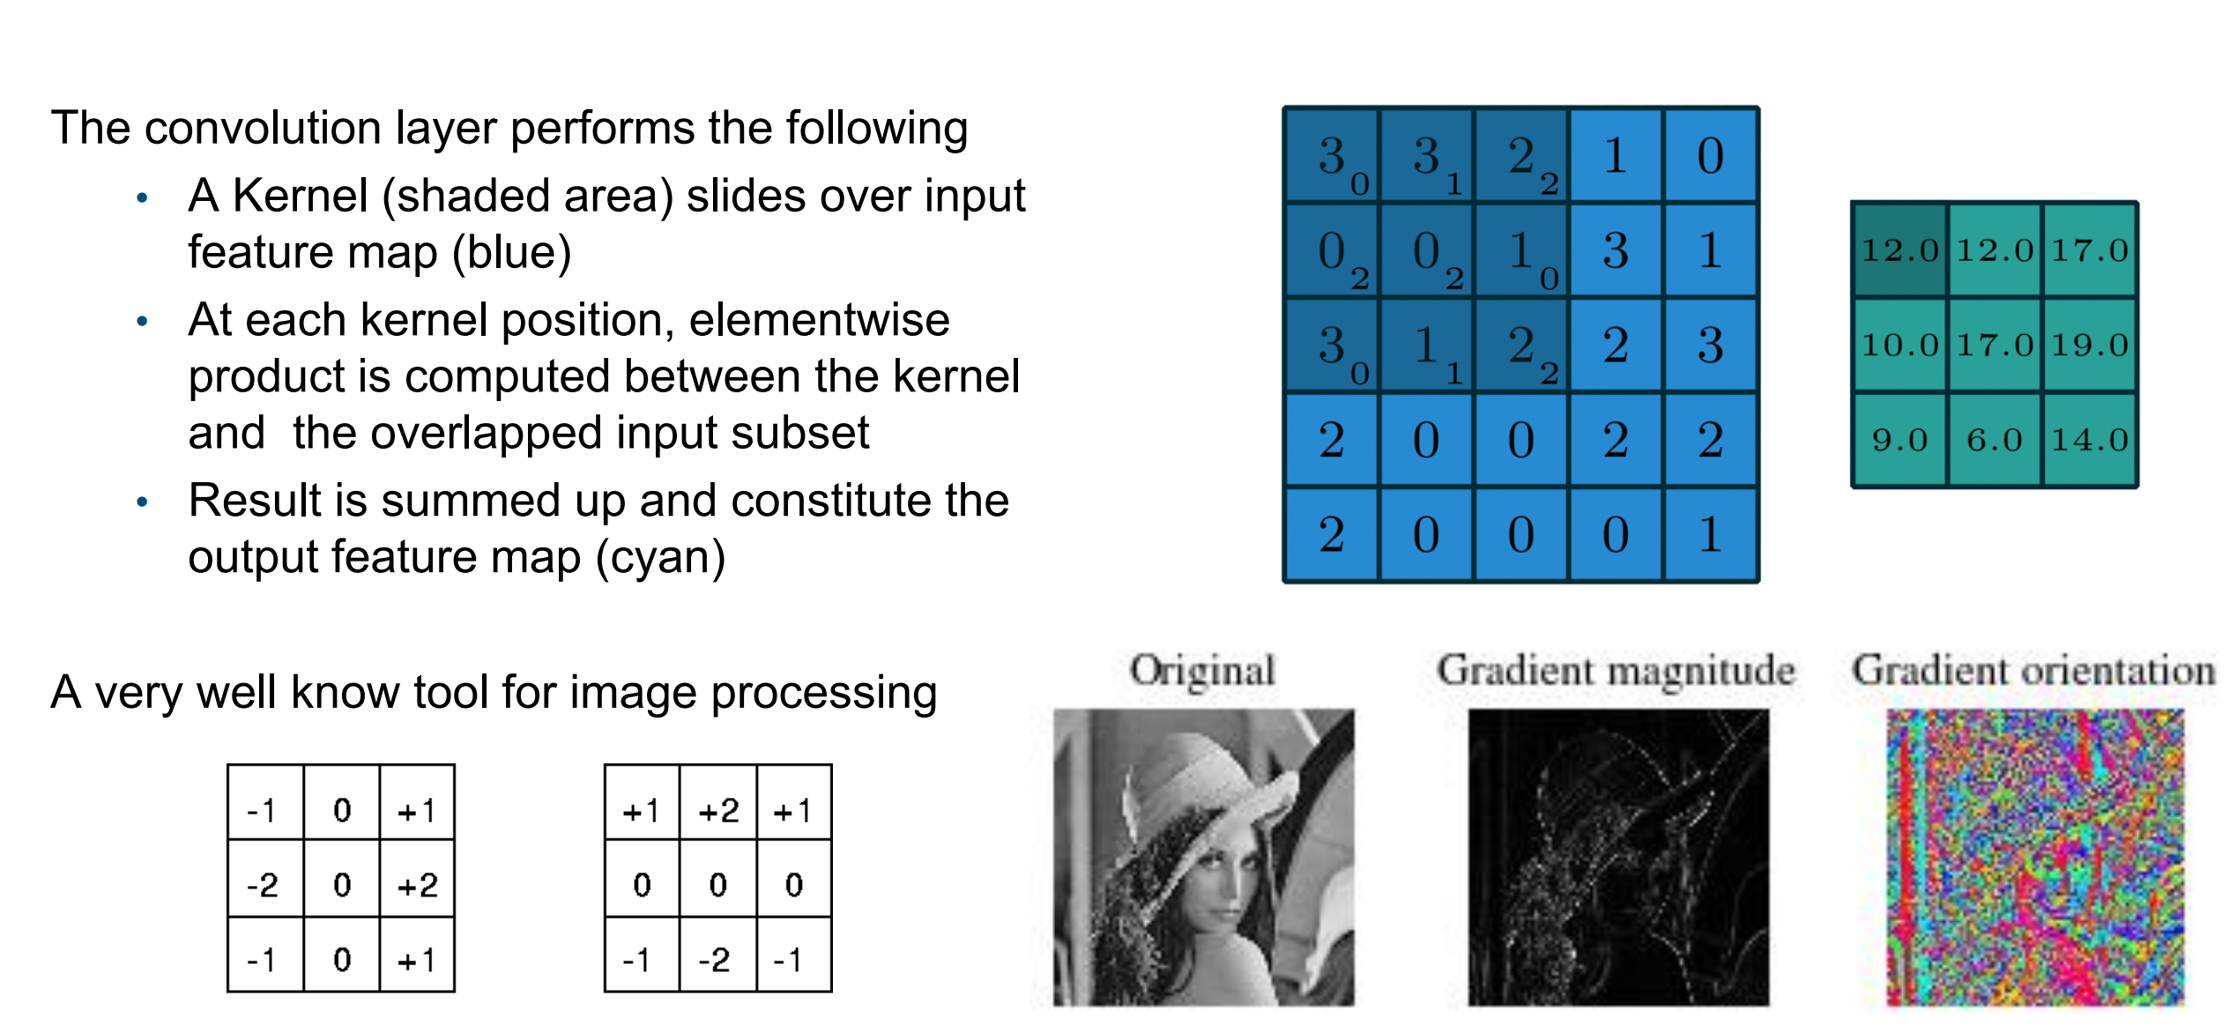
CONVOLUTION 101
Slide by courtesy of professor Matteo Matteucci – Soft Computing Course

Slide 3
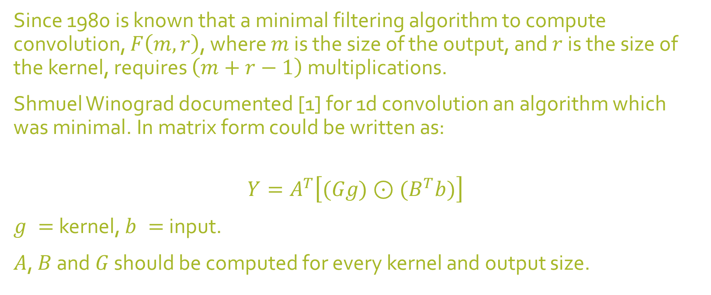
WINOGRAD ALGORITHM
Since 1980 is known that a minimal filtering algorithm to compute convolution, $F\left(m, r\right)$, where $m$ is the size of the output, and $r$ is the size of the kernel, requires $\left(m+r−1\right)$ multiplications.
Shmuel Winograd documented [1] for 1d convolution an algorithm which was minimal. In matrix form could be written as:
$$Y=A^{T}\left[(Gg)⊙(B^{T}b)\right]$$
$g =$kernel, $b =$input.
$A$, $B$ and $G$ should be computed for every kernel and output size.

Slide 4
FROM 1D TO 2D
Bitwise multiplication
Kernel matrix
Input matrix
$$Y=A^{T}\left[\left[GgG^{T}\right]⊙[B^{T}bB]\right]A$$
These matrices are should be computed for every output and kernel size
Output of a single tile*
* Every image $H × W$is divided in multiple tiles and then the algorithm is performed on every tile. The number of tiles for a $m ×m$ kernel is $P = ⌈H/m⌉⌈W/m⌉$.

Slide 5
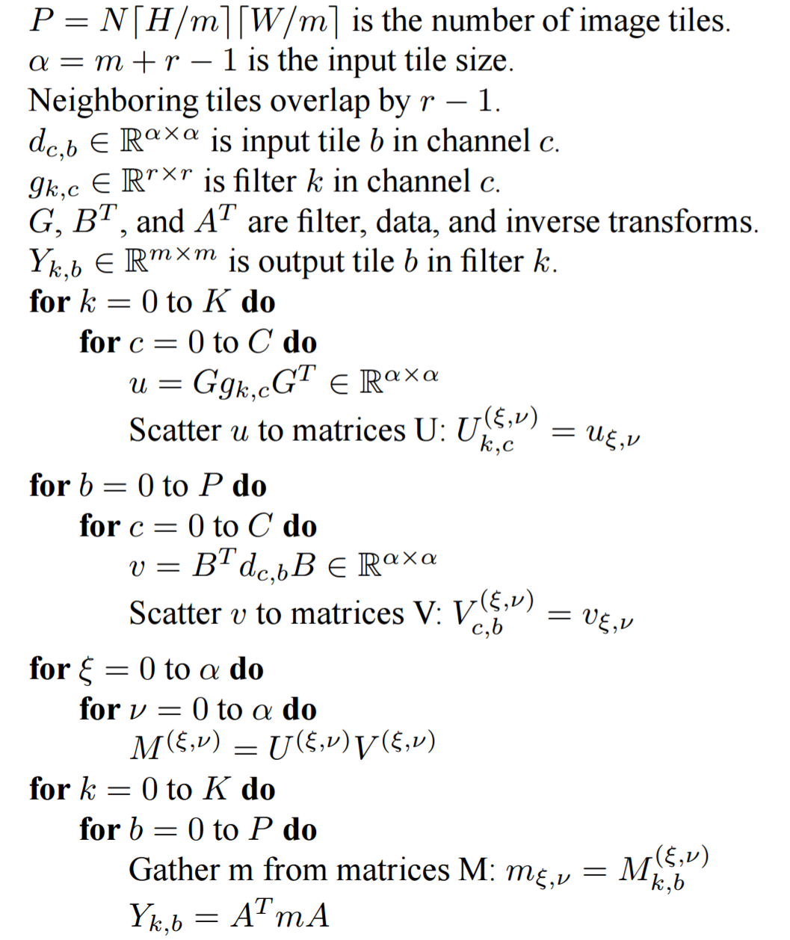
ENTIRE ALGORITHM
Multichannel is supported.
Intermediate matrices U and V are computed.
Multiple channels are collapsed back to one.

Slide 6
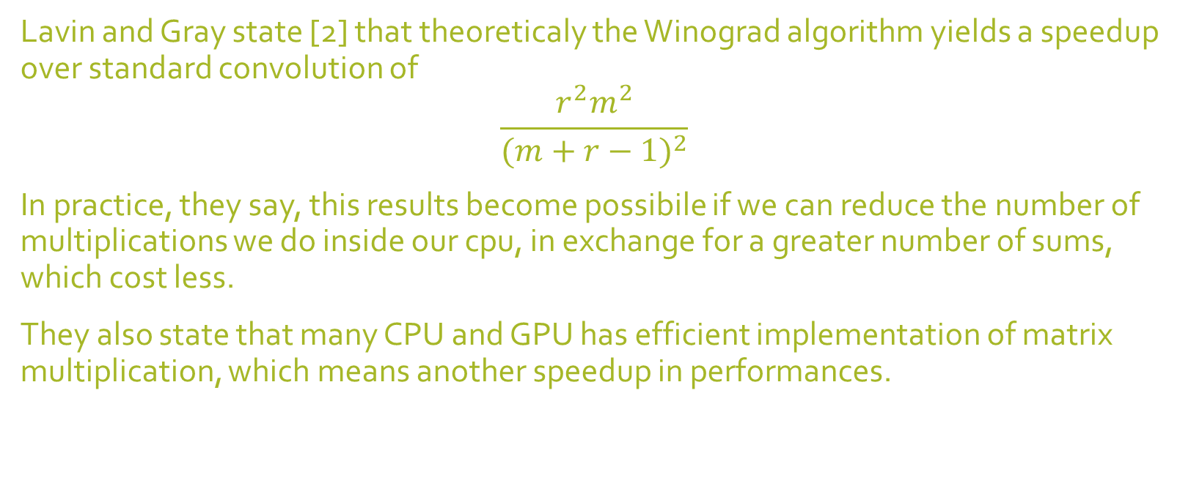
WHAT DO THE SAY?
Lavin and Gray state [2] that theoreticaly the Winograd algorithm yields a speedup over standard convolution of
$$\frac{r^{2}m^{2}}{{(m+r−1)}^{2}}$$
In practice, they say, this results become possibile if we can reduce the number of multiplications we do inside our cpu, in exchange for a greater number of sums, which cost less.
They also state that many CPU and GPU has efficient implementation of matrix multiplication, which means another speedup in performances.

Slide 7
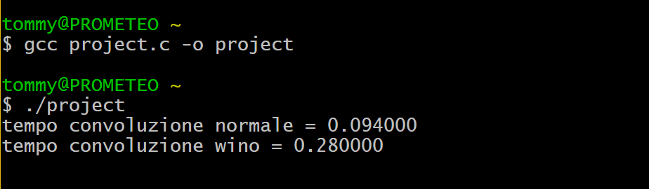
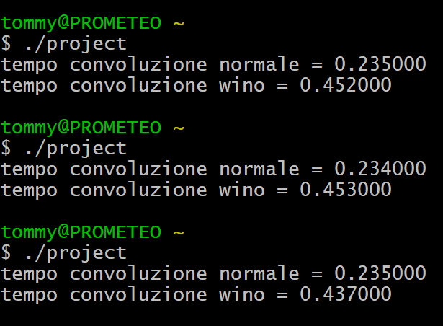
FIRST TRY… POOR RESULTS.
We tried with 3 x 3 output and kernel, 1 channel, many images.
Winograd performs much worse than standard convolution.
Sums are as CPU-intense as multiplication.
Maybe with some preprocessing would be good?
Certain matrices should be calculated only once…
We can cancel multiplication with 0 and 1.
Other optimizations could be perfomed…

Slide 8
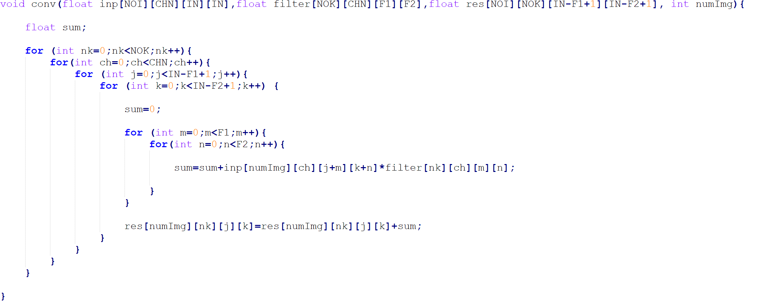
IMPLEMENTATION OF NORMAL CONVOLUTION ALGORITHM
NOI: Number of Image
CHN: channel
IN: input size
NOK: Number of Kernel (for multiple kernel convolution)
F1-F2: Kernel Size

Slide 9
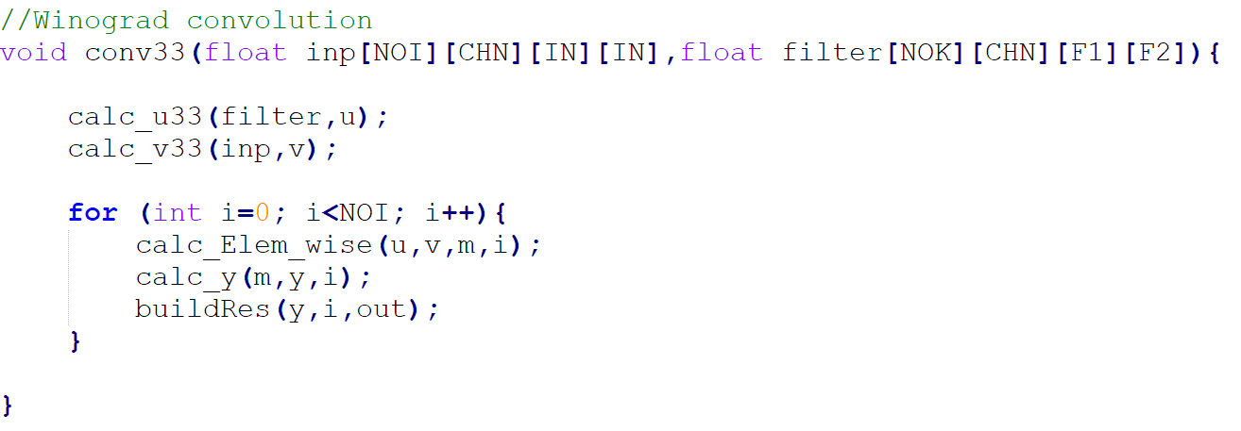
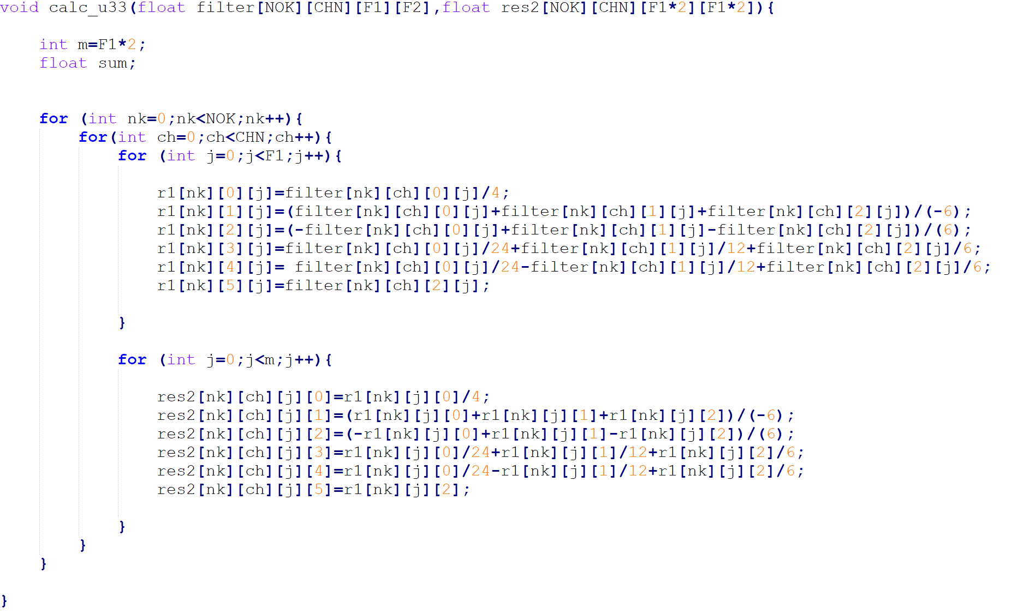
PARTIAL IMPLEMENTATION OF WINOGRAD ALGORITHM

Slide 10
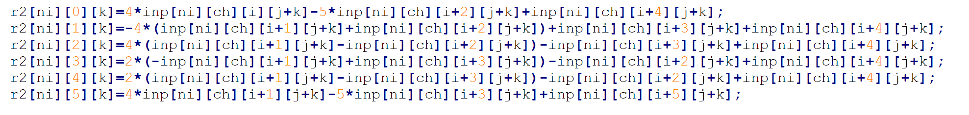
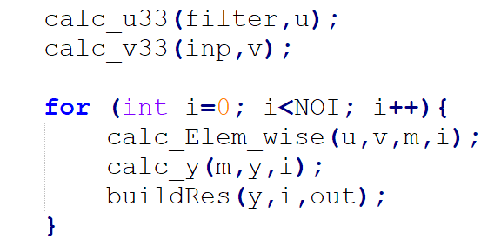
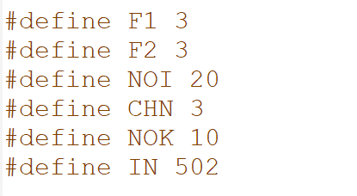
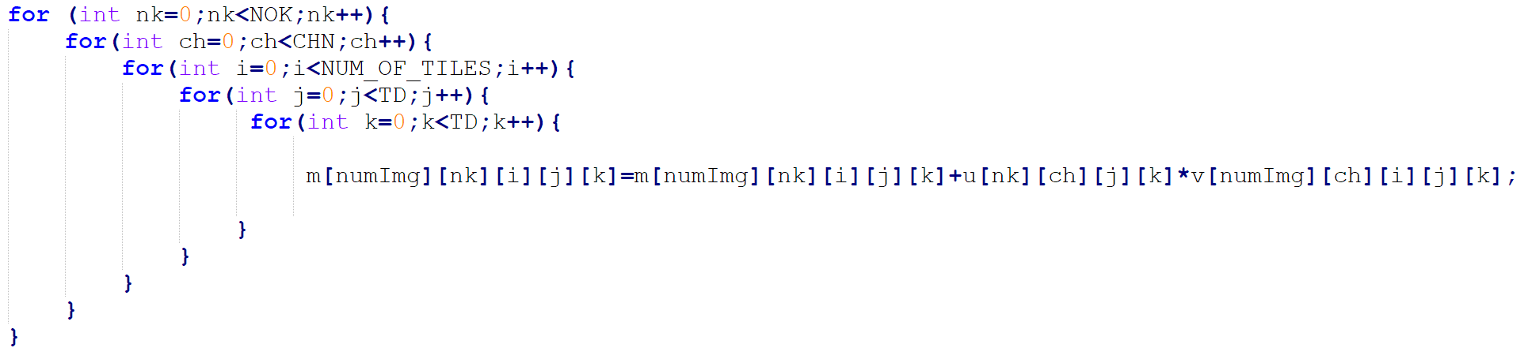
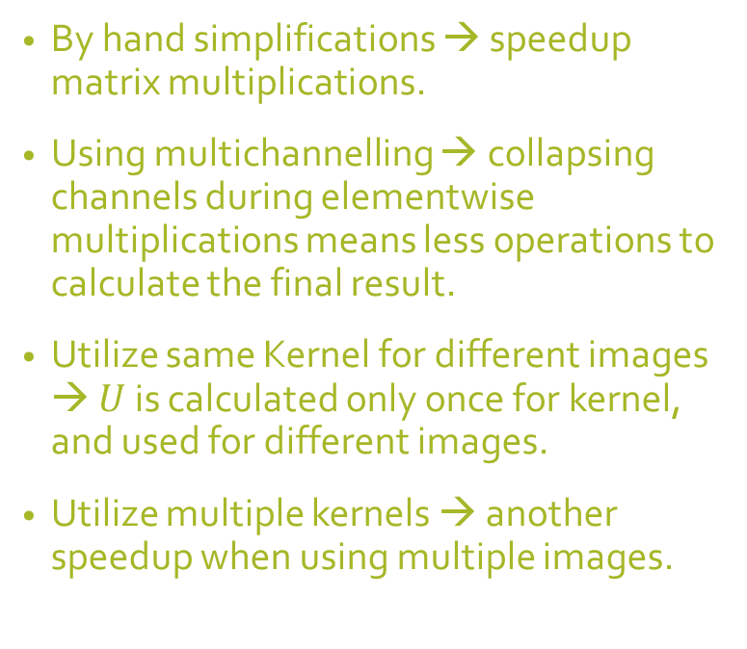
(MAGICIAN’S) TRICKS USED
By hand simplifications → speedup matrix multiplications.
Using multichannelling → collapsing channels during elementwise multiplications means less operations to calculate the final result.
Utilize same Kernel for different images → $U$ is calculated only once for kernel, and used for different images.
Utilize multiple kernels → another speedup when using multiple images.

Slide 11
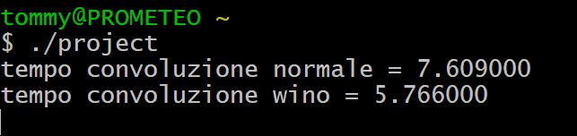

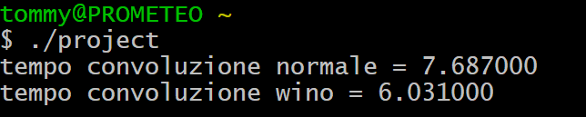
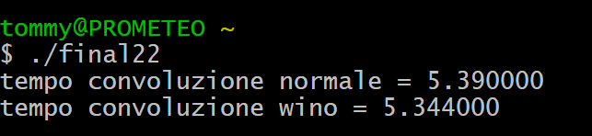
BETTER RESULTS…
2x2 implementation… not so good.

Slide 12

RESULTS FOR A $3×3$ FILTER
*Tests performed on smaller images in order to compile…
*

Slide 13

RESULTS FOR A $2×2$ FILTER
*Tests performed on smaller images in order to compile…
*

Slide 14
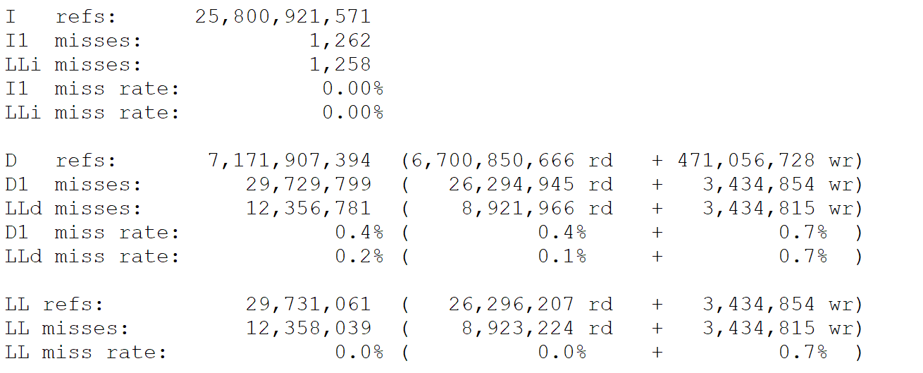
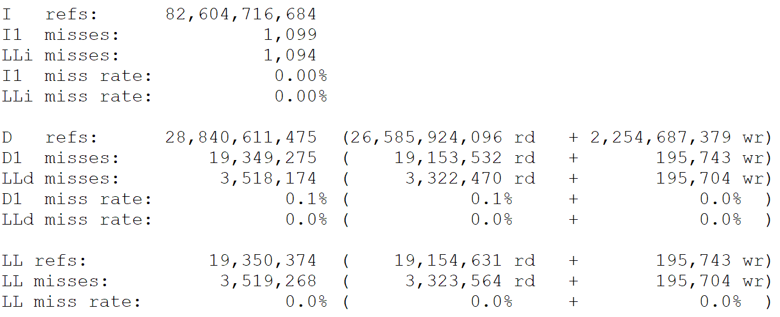
WHAT CACHEGRIND SAYS…
Winograd
Normal

Slide 15
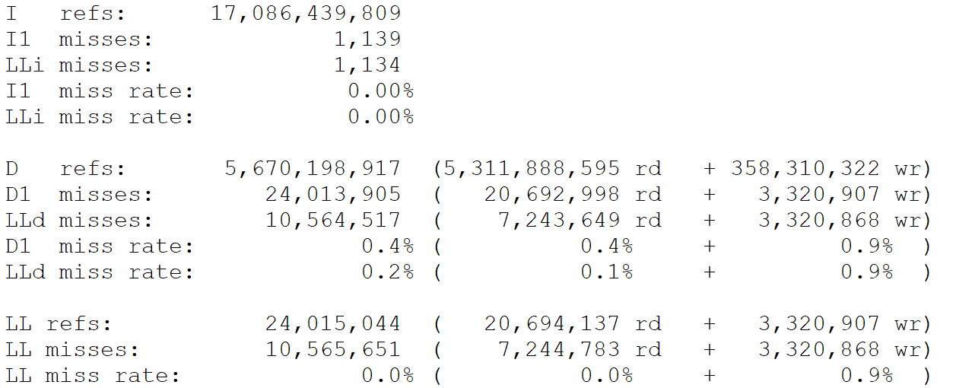
2 X 2 IS EVEN WORSE

Slide 16
CONCLUSIONS
More misses in Winograd convolution, but it is a better algorithm under certain conditions.
The misses are related to temporal and spatial locality principle not exploited by the Winograd algorithm (the matrix is not accessed sequentialy, like in the normal convolution).
Usage of parallelization libraries (C++ AMP, SSE2, ecc…) could lead to better results, along the usage of GPUs to handle matrix multiplications (but these ones also improve normal convolution).
Other libraries, like Openblas, have been used with no percievable effect on the result, sometimes worsening the computation time.

Slide 17
QUESTIONS?

Slide 18
REFERENCES
[1] Shmuel Winograd. Arithmetic complexity of computations, volume 33. Siam, 1980
[2] Andrew Lavin, Scott Gray, Fast Algorithms for Convolutional Neural Networks, https://arxiv.org/abs/1509.09308

